Slide 1
Software Synthesis for embedded processors
Lochana Abhayawardana
lochana.abhayawardana@stud.hshl.de

Slide 2
Motivation
2023
Software Synthesis for embedded processors
2

Slide 3
Agenda
INTRODUCTION TO SOFTWARE SYNTHESIS FOR EMBEDDED SYSTEMS
APPROACHES TO SOFTWARE SYNTHESIS
PROGRAMMING IN HIGH LEVEL-LANGUAGES
COMPILERS
INSTRUCTION SET ARCHITECTURE (ISA)
Reduced Instruction Set Computer (RISC)
ARM CPU ARCHITECTURE
CONCLUSION
2023
Software Synthesis for embedded processors
3

Slide 4
INTRODUCTION
Embedded system in now days
Software Synthesis – a critical role in reducing the design complexity
Different approaches of the software synthesis
High level synthesis
Register Transfer level synthesis
Instruction set synthesis
2023
Software Synthesis for embedded processors
4

Slide 5
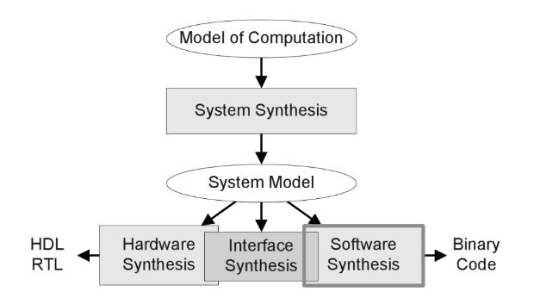
INTRODUCTION TO SOFTWARE SYNTHESIS FOR EMBEDDED SYSTEMS
Software synthesis
System synthesis
Each part below System model uses it as an input and generates an implementation for each Hardware, interface and software synthesis.
The Software Synthesis produces binary code for programmable processing elements.
2023
Software Synthesis for embedded processors
5

Slide 6
APPROACHES TO SOFTWARE SYNTHESIS
Embedded systems : part of the physical control process.
Embedded software can implement a control loop of the physical process through getting readings from the sensors.
Therefore, the software is specific to the underlying hardware, in order to achieve that embedded systems use specialized components (hardware accelerators, processors, DPSs) with communication schemes.
2023
Software Synthesis for Embedded Processors
6

Slide 7
PROGRAMMING IN HIGH LEVEL-LANGUAGES
What is High level Languages:
different from human languages
How to write a program
computers can only understand binary numbers.
translators to lower the level of programming language
2023
Software Synthesis for embedded processors
7

Slide 8
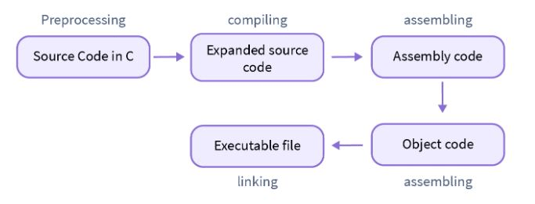
COMPILERS
The high-level languages must be translated into low-level
The compiler create an executable binary directly
Assembly code .S
Linker operations
Libraries (.a, .dill) [2]
[2]
2023
Software Synthesis for embedded processors
8

Slide 9
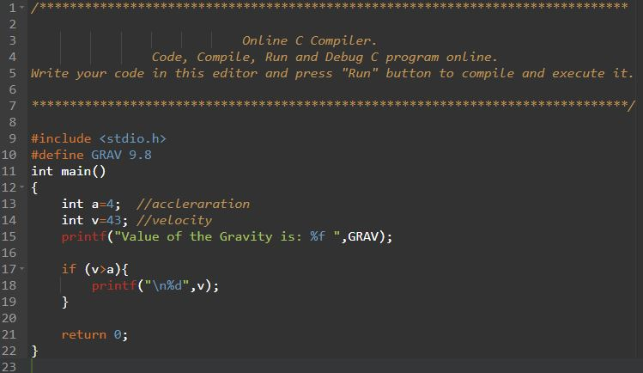
Pre-Processing
Pre-processing is the first step in the compilation process in C
It is performed by the pre-processor tool
All the statements with the symbol of #
Steps,
Comments removal :
2023
Software Synthesis for embedded processors
9

Slide 10
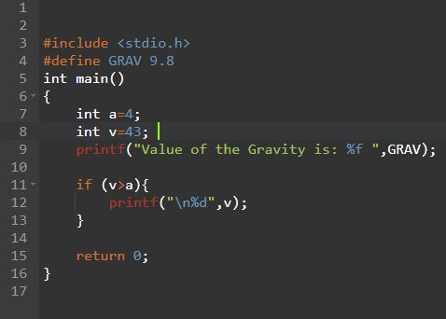
Macros expansion:
2023
Software Synthesis for embedded processors
10

Slide 11
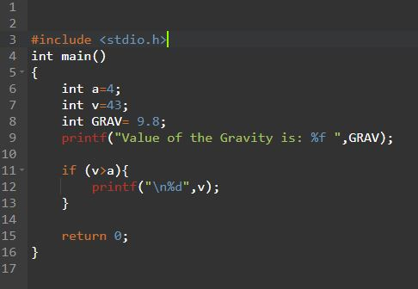
File inclusion:
​
2023
PRESENTATION TITLE
11

Slide 12
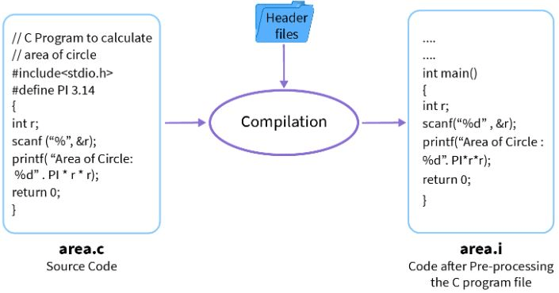
Conditional compilation:
[2]
2023
Software Synthesis for embedded processors
12

Slide 13
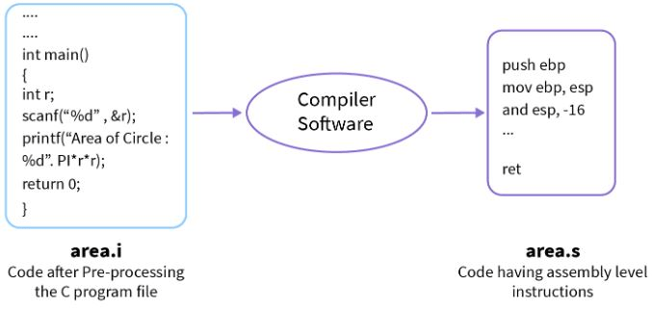
Compiling:
[2]
2023
Software Synthesis for embedded processors
13

Slide 14
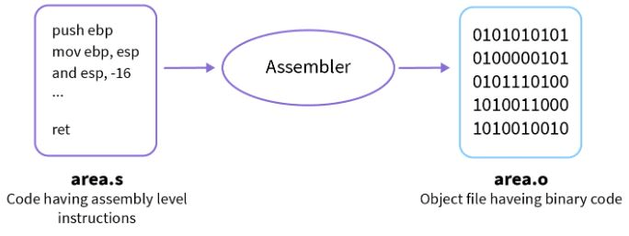
Assembling:
[2]
2023
Software Synthesis for embedded processors
14

Slide 15
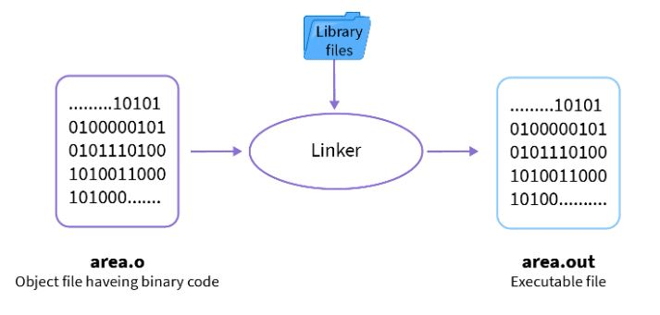
Linking
[2]
2023
Software Synthesis for embedded processors
15

Slide 16
INSTRUCTION SET ARCHITECTURE (ISA)
produce a way to connect software to hardware.
defines the type of instructions to be followed by the processor
Type of operations
Arithmetic /logic instructions:
Data Transfer instructions:
Branch and jump instructions:
2023
Software Synthesis for embedded processors
16

Slide 17
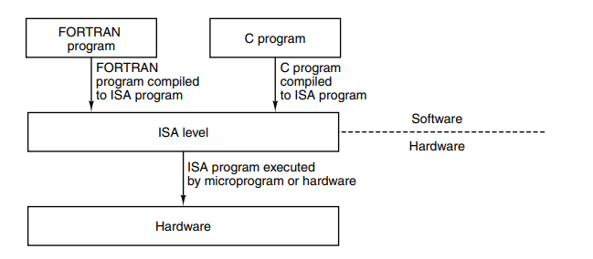
ISA
2023
Software Synthesis for embedded processors
17

Slide 18
Reduced Instruction Set Computer (RISC)
At the start of RISC, the people who were working on microprogramming tools began to rethink the architectural design principles trying to close the “semantic gap” in high-level programming languages and microinstructions.
optimizing compilers that can be used to compile high-level languages into instructions.
These instructions are simpler
2023
Software Synthesis for embedded processors
18

Slide 19
RISC
Key principles of RISC
Functions should be simple.
Microinstructions should not be faster than simple instructions,
Moving software into microcode does not improve its performance or functionality
The RISC architecture prioritizes simple instruction decoding and pipeline execution Use of compiler technology to simplify instructions.
2023
Software Synthesis for embedded processors
19

Slide 20
ARM CPU ARCHITECTURE
ARM is a RISC architecture.
The ARM ISA.
All ARM instructions are 32-bit long
three-operand encoding.
large register file with 16 general-purpose registers, allowing pipelining
Registers:
16 general-purpose registers in the user mode.
Register 15
Register 14 .
Register 13
B. ARM architecture exceptions
2023
Software Synthesis for embedded processors
20

Slide 21
CONCLUSION
2023
Software Synthesis for embedded processors
21

Slide 22
THANK YOU
Lochana Abhayawardana
Lochana.abhayawardana@stud.hshl.de
2023
Software Synthesis for embedded processors
22

